Slide 1
Lecture 9
Feature Engineering

Slide 2
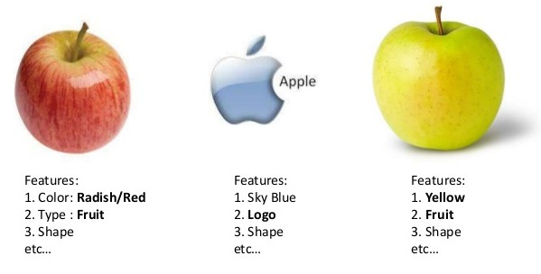
Feature
Definition: an individual measurable property or characteristic of a phenomenon being observed.

Slide 3
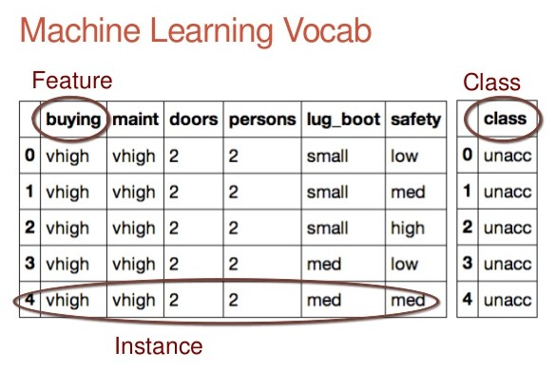

Slide 4
Vocabulary
Instance, observation, sample, example
Feature, attribute, independent variable, predictor, X
Target, class, dependent variable, responses, y

Slide 5
Feature Engineering
What problem does it solve?
What is it?
Why it matters?
How to engineer features?
Where can you learn more?

Slide 6
“feature engineering is another topic which doesn’t seem to merit any review papers or books, or even chapters in books, but it is absolutely vital to ML success. […] Much of the success of machine learning is actually success in engineering features that a learner can understand.”
— Scott Locklin, in “Neglected machine learning ideas”

Slide 7
Problem that it solves
How do you get the most out of your data for predictive modeling?
“Actually the success of all Machine Learning algorithms depends on how you present the data.”
— Mohammad Pezeshki

Slide 8
Importance of Feature Engineering
Better features means flexibility.
Better features means simpler models.
Better features means better results.

Slide 9
What is Feature Engineering?
Feature engineering is the process of transforming raw data into features that better represent the underlying problem to the predictive models, resulting in improved model accuracy on unseen data.

Slide 10
What is Feature Engineering?
Representation problem.
Turn inputs into things the algorithm can understand.
Know the best representation to use a priori: HARD.
Art.

Slide 11
Sub-problems
Feature importance
Feature extraction
Feature selection
Feature construction

Slide 12
Feature construction
Think about how to expose structures in the data to predictive modeling algorithms.
Aggregating or combining features.
Decomposing or splitting features.
Manual, slow, requires human brain power.

Slide 13
Examples
Decompose Categorical Attributes.
Decompose a Date-Time.
Reframe Numerical Quantities.

